Slide 1
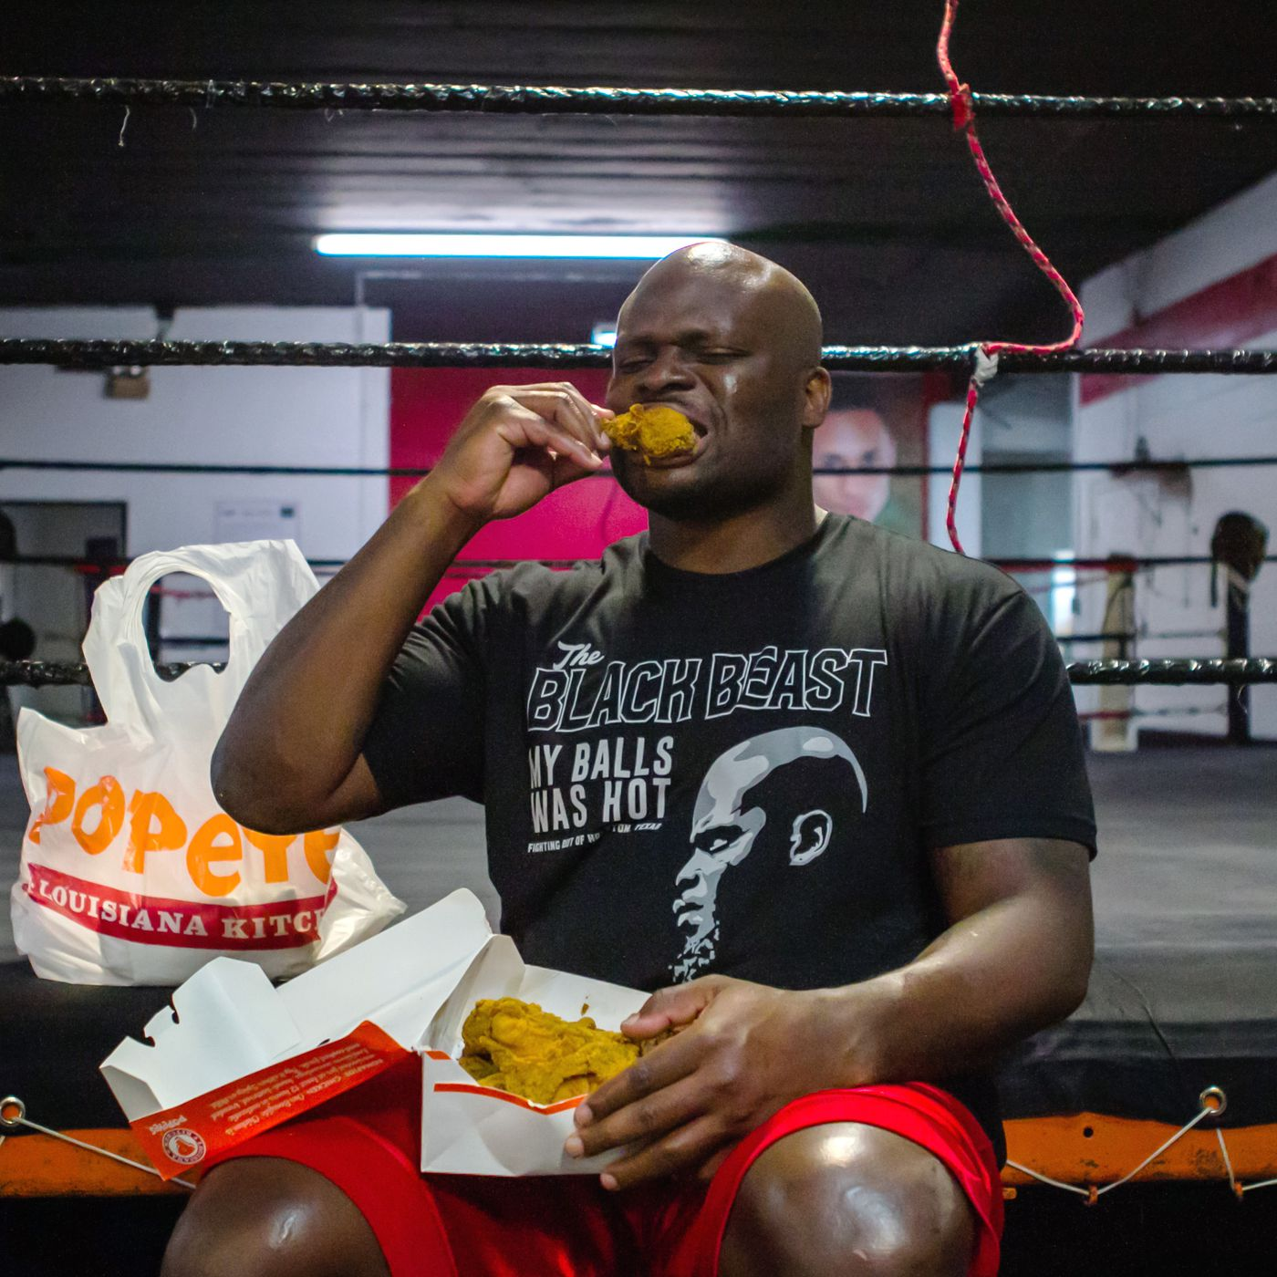
Popeye’s Management Application
By: Jessica Park, Farah Siddiqui ,Betelhem Taddele ,Danny Nguyen, Jatin Chauhan ,Munam Ghazanfar, Ninh Ngo

Slide 2

Functional Requirements
Process Oriented:
Store large amount of data
Upload photos
Create checklist system (to-do, rush readiness)
Communication within app
Create critical reports and summary reports
Ability to set reminders
Information Oriented:
Store financial information (sales, labor percentile)
Store drive-thru analytics
Store all info for 3 years minimum
“Web Development, Mobile App Development, Android, Mobile Phone Case, Mobile Phone Accessories PNG Image with Transparent Background.” Kisspng, Web Development, Mobile App Development, Android, Mobile Phone Case, Mobile Phone Accessories PNG image with transparent background.

Slide 3
Non-functional Requirements
Operational: The system will be able to run on both android and apple devices, integrate with existing inventory system, and backup files to secondary drive
Performance: The system should be available during all hours of a routine work day; costs can be saved by turning off the system during certain hours (0000 - 0800).
Security: The backups should be stored in 2 locations, on the cloud for quick access and within a locked storage area.
Cultural/Political: Managers shall only be able to view information about their own store.

Slide 4

Interview #1 of Owner
Name of Interviewee: Syed Abid Iqbal
Position of Interviewee: Owner
Date & Time of Interview: 3/23/2019
Name of Interviewer: Farah Siddiqui
Purpose of Interview:
Understand the current process of their transition of information.
Determine the requirements for the future system.
Gain insight on what Mr. Iqbal needs to needs to be improved, and what additional thoughts he had on our proposed system.

Slide 5
Summary of Interview
Mr.Iqbal expressed his concern regarding:
Lack of the ability to data on time.
Gather information is very time consuming.
When Manager miss a task such as, not doing HACCP log can cause risk the consumer healths.
If Manager fail to report the accurate information on time it cause him to lose money.

Slide 6
Interview #2 of Manager
Name of Interviewee: Melissa Howell
Position of Interviewee: Manager
Date & Time of Interview: 3/24/19
Name of Interviewer: Adil Mufti
Purpose of Interview:
The day to day tasks that a manager deals with and what may be challenging.
What functions and features would be convenient to have on the application from a managers point of view.
The organization skills that are currently in place with documents and important files.

Slide 7
Summary of Interview
Melissa mentioned how:
It is a hassle for them to keep track of previous documents because it wasn’t paperless.
Communication between managers could be stronger because they currently use their smartphone in a group chat.
Ensuring that the staff is completing their tasks was stressful to handle so the use of the checklist will help ensure everyone is doing what they need to before they leave.

Slide 8

Observations
This restaurant popeyes is located at Essex,MD.
lobby for 45 people.
The daily operation includes doing HACCP logs, rush readiness checklist and Daily Food Excellence Audit.
The staff records all of these activities in the red book.
Red book is a managers book which tracks and analyze daily operations anytime and anywhere and creates tasks as managers do their walk-throughs.
On the left side of the drive-thru window, there is a monitor which records the speed of the drive-thru.
Most of the communication among the management team is done via group chat.

Slide 9
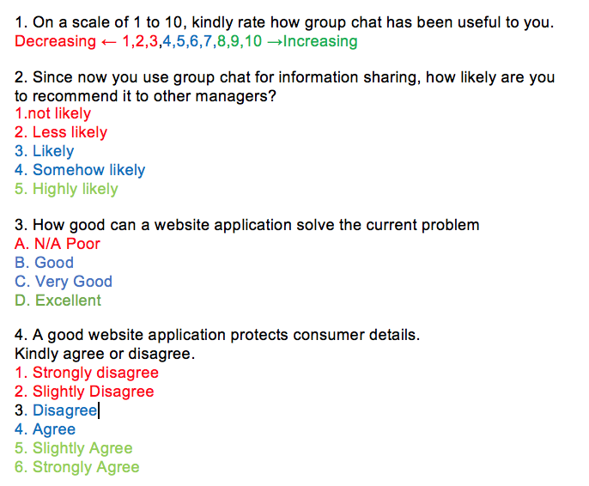
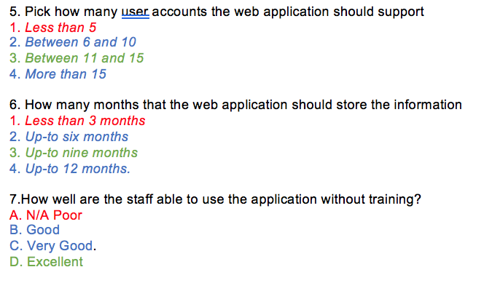
Questionnaire

Slide 10
Document Analysis
requires identification of user requirements, functionalities and features that should be incorporated as per the survey
After interview, its determined that the food chain owns five food stores and each store is under the similar chain of management
This suggests that application will be used by all store managers
literature analysis will be conducted to understand how to incorporate the user requirements in a web application for efficient management
literature regarding all the financial of store details shall be analyzed to ensure that security is at maximum.

Slide 11
Sample Use Case
Use Case Name: Input Financial Information | ID: 3 | Priority: High
Actor: Manager, Owner
Description: Allows user to add the financial information sales, labor percentage periodic
Trigger: Manager needs to record financial numbers Trigger Type: External
Preconditions: User is logged in to the system
Normal Course: User enters financial information sales, labor percentage periodic to be stored in system and viewed by owner
Postconditions: Information sales and labor percentage periodic are stored
Exceptions: E1: Invalid input (symbols, letters) System prompts user to enter number values

Slide 12
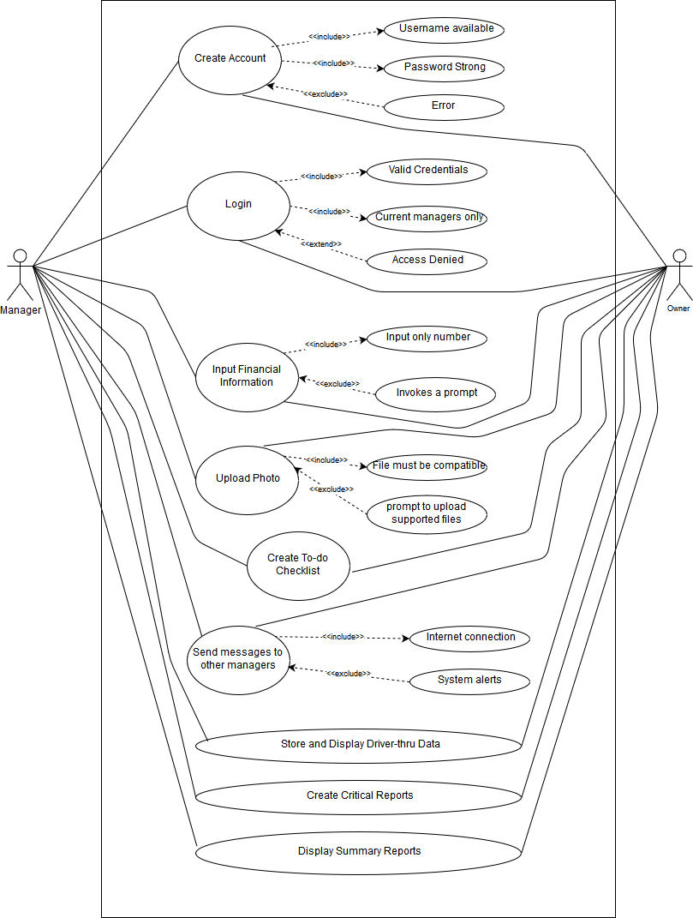
Use Case
Diagram

